Slide 1
Programming for Engineers in Python
Fall 2020
Lecture 12:
Data Analysis using Pandas

Slide 2


Slide 3

Programming skills for data analysis are essential in the era of data explosion

Slide 4

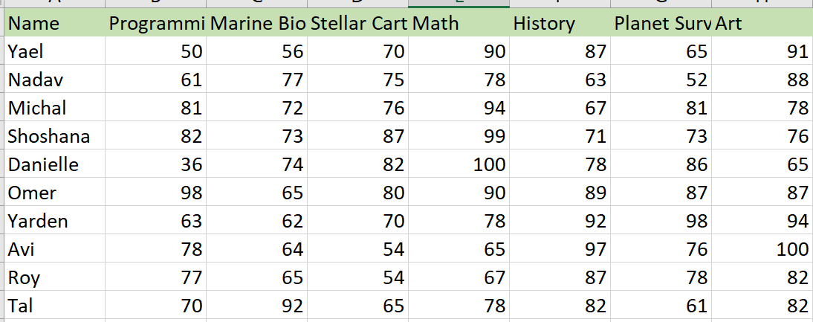
Today
Data Analysis using Pandas

Slide 5
Pandas
The pandas package is the most popular tool at the disposal of Data Scientists and Analysts working in Python today.
Pandas is built on top of the NumPy package, plotting functions from Matplotlib, and machine learning algorithms in Scikit-learn.

Slide 6
Grade Analysis (Example for Data Analysis using Pandas)
We’ll use the following imports:
import pandas as pd
import matplotlib.pyplot as plt

Slide 7
Grade Analysis
In this example we will analyze the following grade sheet in python.
We assume the table is saved as a CSV file.

Slide 8
Reading the grades table from file
We start by reading the table into a dataFrame
DataFrames are two-dimensional(2-D) data structure defined in pandas which consists of rows and columns.
inputFileName = "StudentsGrades.csv" df = pd.read_csv(inputFileName)
StudentGrades.csv
Column Headers
Data Frame
Row Headers

Slide 9
Dataframe
Every row in a dataframe has an index
We can also create a dataframe from a dict
d = {'col1': [1, 2], 'col2': [3, 4]} df = pd.DataFrame(data=d) print(df)
col1 col2
0 1 3
2 4
Headers
Indexes

Slide 10
Dataframe
We can also create a dataframe from a numpy array
df = pd.DataFrame(np.array([[1, 2, 3], [4, 5, 6], [7, 8, 9]]),columns=['a', 'b', 'c']) print(df)
a b c
0 1 2 3
1 4 5 6
2 7 8 9

Slide 11
Headers
inputFileName = "StudentsGrades.csv" df = pd.read_csv(inputFileName) # iterating the columns for col in df.columns: print(col)
Name
Programming
Marine Biology
Stellar Cartography
Math
History
Planet Survival
Art
StudentGrades.csv

Slide 12
Data Display
print(df) # display dataframe
Name Programming Marine Biology ... History Planet Survival Art
0 Yael 50 56 ... 87 65 91
1 Nadav 61 77 ... 63 52 88
2 Michal 81 72 ... 67 81 78
3 Shoshana 82 73 ... 71 73 76
4 Danielle 36 74 ... 78 86 65
5 Omer 98 65 ... 89 87 87
6 Yarden 63 62 ... 92 98 94
7 Avi 78 64 ... 97 76 100
8 Roy 77 65 ... 87 78 82
9 Tal 70 92 ... 82 61 82
10 Yaniv 100 64 ... 61 88 90
11 Tom 98 76 ... 98 92 80
12 Adi 76 87 ... 88 84 70
[13 rows x 8 columns]

Slide 13
Data Display
print(df[“History"]) # display specific column by name
0 87
1 63
2 67
3 71
4 78
5 89
6 92
7 97
8 87
9 82
10 61
11 98
12 88
Name: History, dtype: int64

Slide 14
Basic operations
print(len(df)) #num of rows (excluding the header)
10
print(df.dtypes) #types of columns
Name object
Programming int64
Marine Biology int64
Stellar Cartography int64
Math int64
History int64
Planet Survival int64
Art int64

Slide 15
Basic operations
print(df.info()) # provides the essential details about your dataset
RangeIndex: 10 entries, 0 to 9
Data columns (total 8 columns):
Name 10 non-null object
Programming 10 non-null int64
Marine Biology 10 non-null int64
Stellar Cartography 10 non-null int64
Math 10 non-null int64
History 10 non-null int64
Planet Survival 10 non-null int64
Art 10 non-null int64
dtypes: int64(7), object(1)
memory usage: 768.0+ bytes

Slide 16
Arithmetic Operations
Arithmetic operations between numeric columns works as 2 numpy arrays:
print(df["Art"] - df["History"]) 0 4
1 25
2 11
3 5
4 -13
5 -2
6 2
7 3
8 -5
9 0
10 29
11 -18
12 -18
dtype: int64

Slide 17
Basic operations
Add a new column/row
Delete a column/row
Alter column

Slide 18
Delete a column
Delete the student name column
df_without_names = df.drop('Name', 1) #where 1 is the axis number (0 for rows and 1 for columns.)

Slide 19
Add a new column
Calculate the average grade per student and place it in new column “Avg”:
def get_avg(row): row_without_name = row.drop('Name') return row_without_name.mean() df["Avg"] = df.apply(lambda row: get_avg(row), axis=1 )
df.apply applies a generic function on each row/column depending on the given axis
Shorter version: df["Avg"] = df.mean(axis=1, numeric_only=True)
Ignore the student’s name
Ignore any non-numeric column

Slide 20
Add a new row
Dana is a new student
ns = {'Name':"Dana",'Programming':76,'Marine Biology':65,
'Stellar Cartography':98,'Math':87,'History':65,
'Planet Survival':89,'Art':100} df = df.append(ns,ignore_index=True)
This can be a dictionary, a series, or a dataframe. If adding a dictionary, ignore_index must be True

Slide 21
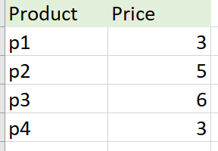
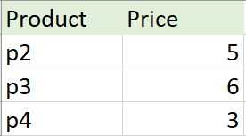
Delete a row
Delete a row based on a condition
df = df[df.Product != 'p1']

Slide 22
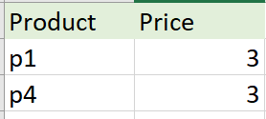
Delete a row
Delete a row based on a condition
df = df[df.Price < 5]

Slide 23
Alter Column
We wish to give a passing grade to all students in Programming:
We use df.loc[rows,columns] to get the cells we wish to display or alter
df.loc[df["Programming"] < 60, "Programming"] = 60
Row condition
Column to alter

Slide 24
Let’s start analyzing the data!
Count failing grades (in total and per student).
Visualize the data
Get average grades per student/course.

Slide 25
Total number of fails
df_no_names = df.drop('Name', 1) #where 1 is the axis number (0 for rows and 1 for columns.)
print(df_no_names[df_no_names< 60].count())
Programming 2
Marine Biology 1
Stellar Cartography 2
Math 0
History 0
Planet Survival 1
Art 0
#total num of fails
print(df_no_names[df_no_names < 60].count().sum())
6
How many grades below 60 are there in each course?

Slide 26
Number of fails per student
How many grades below 60 are there per student?
Iterate over all rows
for index, row in df.iterrows(): row_without_name = row.drop('Name') print(row["Name"],row_without_name[row_without_name < 60].count())
Yael 2
Nadav 1
Michal 0
Shoshana 0
Danielle 1
Omer 0
Yarden 0
Avi 1
Roy 1
Tal 0

Slide 27
Getting average grade per student
def get_avg(row): row_without_name = row.drop('Name') return row_without_name.mean() df["Avg"] = df.apply(lambda row: get_avg(row), axis=1) print(df[["Name","Avg"]])
Name Avg
0 Yael 72.714286
1 Nadav 70.571429
2 Michal 78.428571
3 Shoshana 80.142857
4 Danielle 74.428571
5 Omer 85.142857
6 Yarden 79.571429
7 Avi 76.285714
8 Roy 72.857143
9 Tal 75.714286
What is the average of each student?
Add new column based on row values
Display only columns in list

Slide 28
Average grade per student
Get the name of the student with the highest average grade
max_id = df['Avg'].idxmax() #get the index of the row with maximal value print(df.loc[max_id]["Name"]) #loc: get a row by index
Omer

Slide 29
Getting average grade per course
courseNames = ['Programming','Marine Biology','Stellar Cartography', 'Math','History','Planet Survival', 'Art'] avg_per_course = {} avg_per_course["Name"] = None for course in courseNames: avg_per_course[course] = df[course].mean() df = df.append(avg_per_course, ignore_index=True)
print(avg_per_course)
{'Name': None, 'Programming': 69.6, 'Marine Biology': 70.0, 'Stellar Cartography': 71.3,
'Math': 83.9, 'History': 81.3, 'Planet Survival': 75.7, 'Art': 84.3}
Shorter Version: df = df.append(df.mean(axis=0, numeric_only=True), ignore_index=True)
Add new row
Adds the average row with Name = NaN (not a number)

Slide 30
Average grade per course
Get the name of the course with the highest average grade
Shorter Version:
df.drop('Name', 1).mean(axis=0).idxmax()
df_without_names = df.drop('Name', 1) df_without_names['Max'] = df_without_names.idxmax(axis=1)
#axis=1 to find the column with the greatest value on each row print(df_without_names['Max'].tolist()[-1])
Art
Get the values of this column. The last row is the average grades per course.

Slide 31
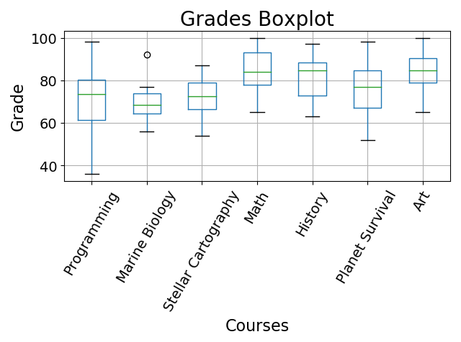
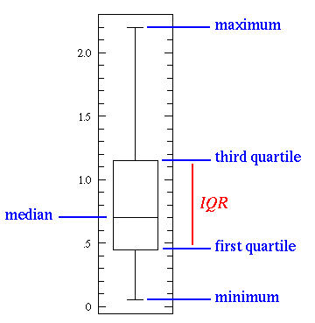
Plotting a boxplot of the grades

Slide 32
Plotting a boxplot of the grades
courseNames = ['Programming','Marine Biology','Stellar Cartography', 'Math','History','Planet Survival', 'Art'] boxplot = df.boxplot(column=courseNames) plt.title ('Grades Boxplot', fontsize=20) plt.xlabel('Courses', fontsize=16) plt.ylabel('Grade', fontsize=16) plt.xticks(range(1,len(courseNames)+1), courseNames, rotation=60) plt.tick_params(labelsize=14) plt.tight_layout() plt.show()

Slide 33
Advanced operations in pandas
Select – select rows based on a condition
Join tables
Groupby - group large amounts of data and compute operations on these groups.

Slide 34
Select
A basic operation is to select rows based on a condition
Get all students who have failed (grade < 60) in Programming
Get all students who have failed in Programming or Stellar Cartography
df = df.loc[df['Programming'] < 60] print(df["Name"].tolist())
['Yael', 'Danielle']
For and use &
df = df.loc[(df['Programming'] < 60) | (df['Stellar Cartography'] < 60)] print(df["Name"].tolist())
['Yael', 'Danielle', 'Avi', 'Roy']

Slide 35
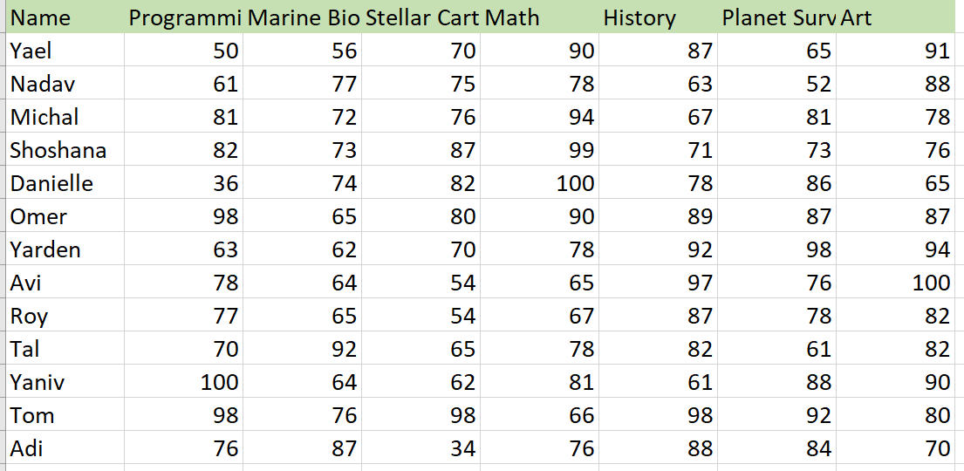
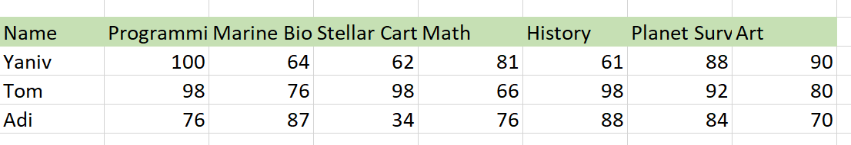
Join
Merge two tables (with the same column names):
=
+
df1 = pd.read_csv("StudentsGrades1.csv") df2 = pd.read_csv("StudentsGrades2.csv") frames = [df1, df2] result = pd.concat(frames)

Slide 36
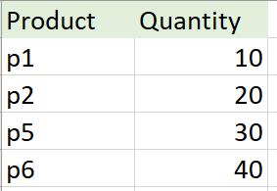
Inner join vs outer join
How to merge these two tables?
Inner join – take the intersection of the two tables
Outer join – take the union of the two tables
+

Slide 37
Inner Join
df1 = pd.read_csv("ex1.csv") df2 = pd.read_csv("ex2.csv") frames = [df1, df2] result = pd.merge(df1, df2, on='Product', how = 'inner') print(result)
Product Price Quantity
0 p1 3 10
1 p2 5 20

Slide 38
Outer Join
df1 = pd.read_csv("ex1.csv") df2 = pd.read_csv("ex2.csv") frames = [df1, df2] result = pd.merge(df1, df2, on='Product', how = ‘outer') print(result)
Product Price Quantity
0 p1 3.0 10.0
1 p2 5.0 20.0
2 p3 6.0 NaN
3 p4 3.0 NaN
4 p5 NaN 30.0
5 p6 NaN 40.0

Slide 39
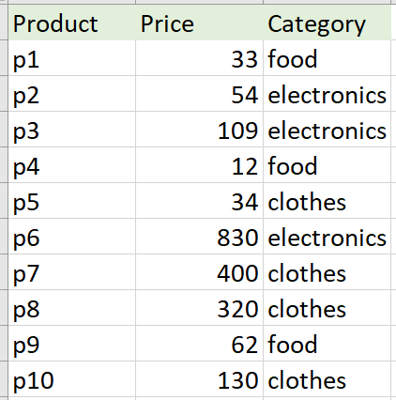
Groupby
Pandas dataframe.groupby() function is used to split the data
into groups based on some criteria.

Slide 40
Groupby
Count the number of products in each category
df = pd.read_csv("ex1.csv") categories = df.groupby(["Category"]) for name, group in categories: print(name, len(group))
clothes 4
electronics 3
food 3

Slide 41
Groupby
Get the average price of each category
print(df.groupby(['Category'])['Price'].mean())
Category
clothes 221.000000
electronics 331.000000
food 35.666667

Slide 42
Groupby
Get the highest price in each category
print(df.groupby(['Category'])['Price'].max())
Category
clothes 400
electronics 830
food 62

Slide 43
Summery: Pandas vs Numpy
DataFrame.to_numpy() gives a NumPy representation of the underlying data.
This can be an expensive operation when your DataFrame has columns with different data types, since NumPy arrays have one dtype for the entire array, while pandas DataFrames have one dtype per column.
NumPy is a more basic library that provides the building blocks of array based data manipulation.
Pandas works to provide a streamlined way to use this functionality.

